Slide 1

Taylor Bacon, Chloe Barreau, Cynthia Liang, Jenny Zhi
194H Project Recap
Notes:
Intro - 30 sec
Solution - 30 sec
Outline - 30 sec
Video - 2 min
Needfinding - 1 min
Sketches - 30 sec
Low fi - 1 min
Mid fi - 1 min
Hi fi / demo - 3.5 min
Future - 1 min
Summary - 30 sec
Total = 12 min

Slide 2
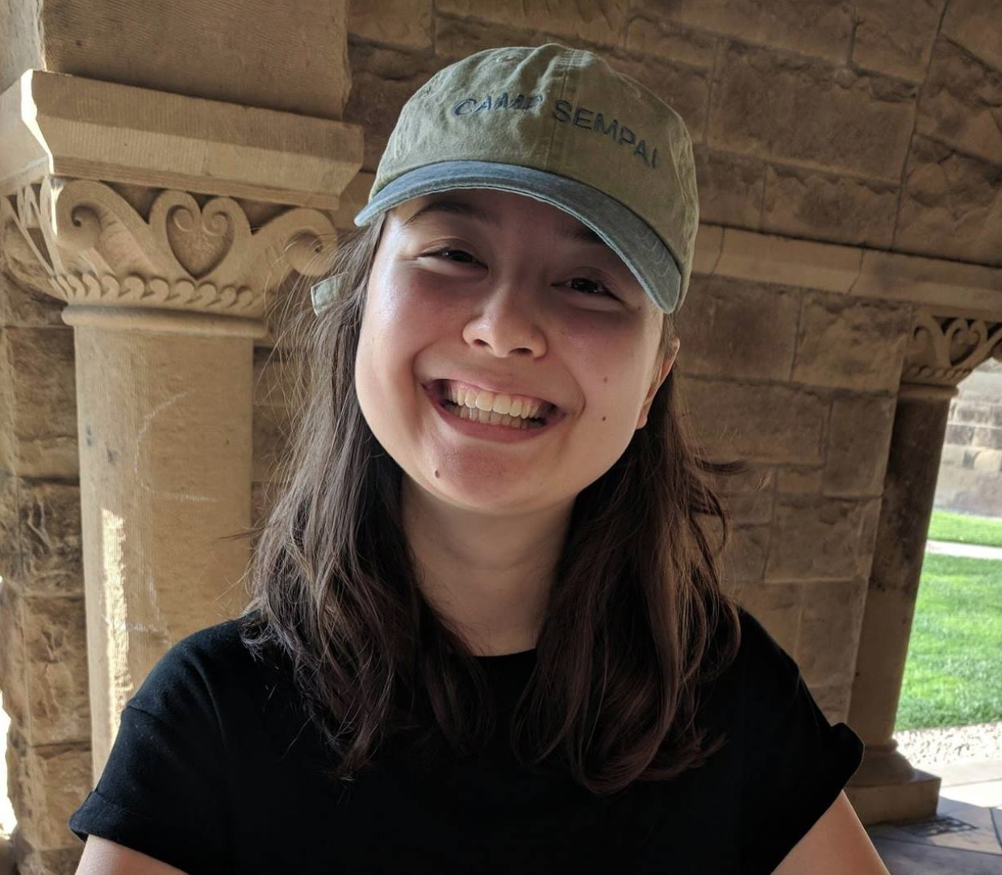
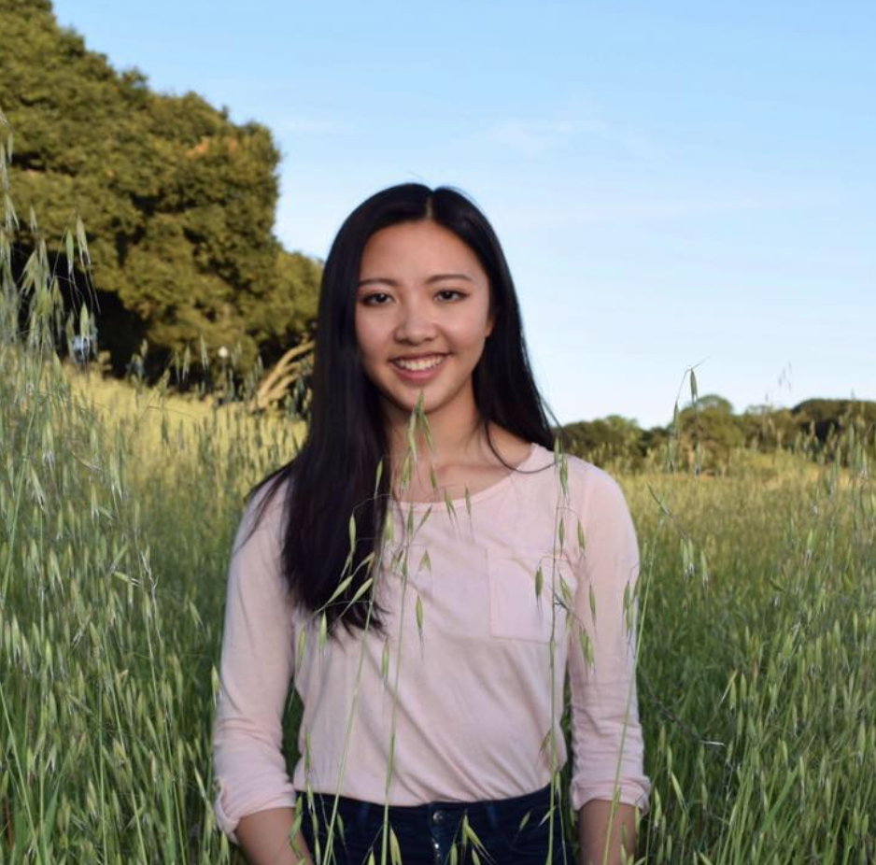

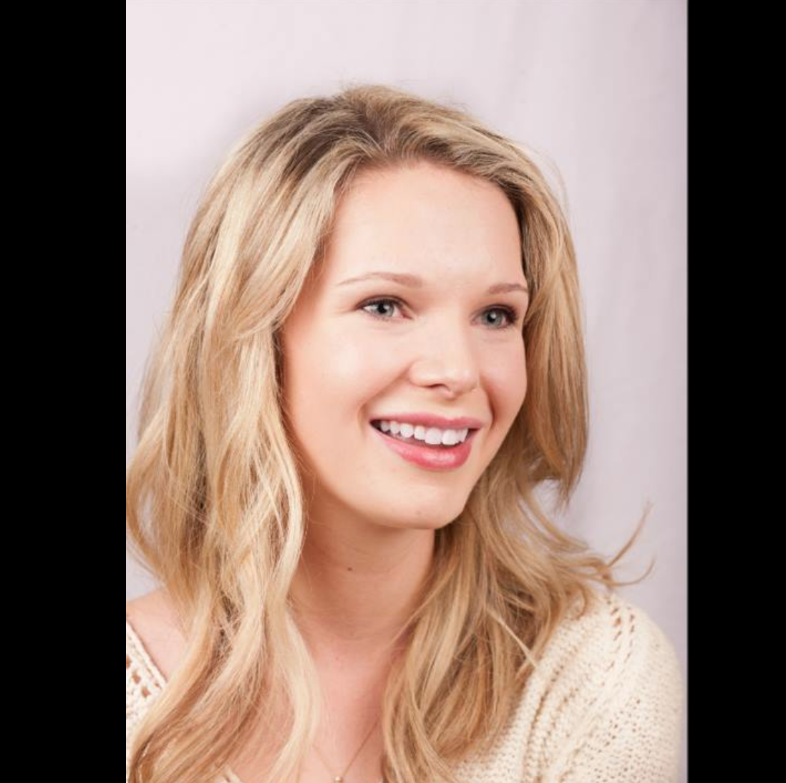
Meet the Team
Chloe Barreau
Cynthia Liang
Jenny Zhi
Taylor Bacon

Slide 3
overview
design evolution
demo
future
summary
Notes:
Living spaces and lifestyles . objects contribute to lifestyle in living spaces.
Needfinding where we went to X. From there..

Slide 4
declutter meaningfully
People often find themselves keeping a lot of clutter. Many of these objects stay because they hold sentimental value, but not necessarily functional use.
Flutter adds emotional security to the decluttering process, allowing people to find others who will value or add meaning to the item.
overview
design evolution
demo
future
summary
value proposition
problem
solution
Notes:
We are often reluctant to declutter because objects hold sentimental value. We make the process of giving items easy, social, and emotionally rewarding. Through closed, tight-knit communities, Flutter encourages a sense of trust. By systematically encouraging receivers of treasured objects to share their side of the story, Flutter creates deeply human connections behind every transaction, giving people the agency to declutter meaningfully.

Slide 5
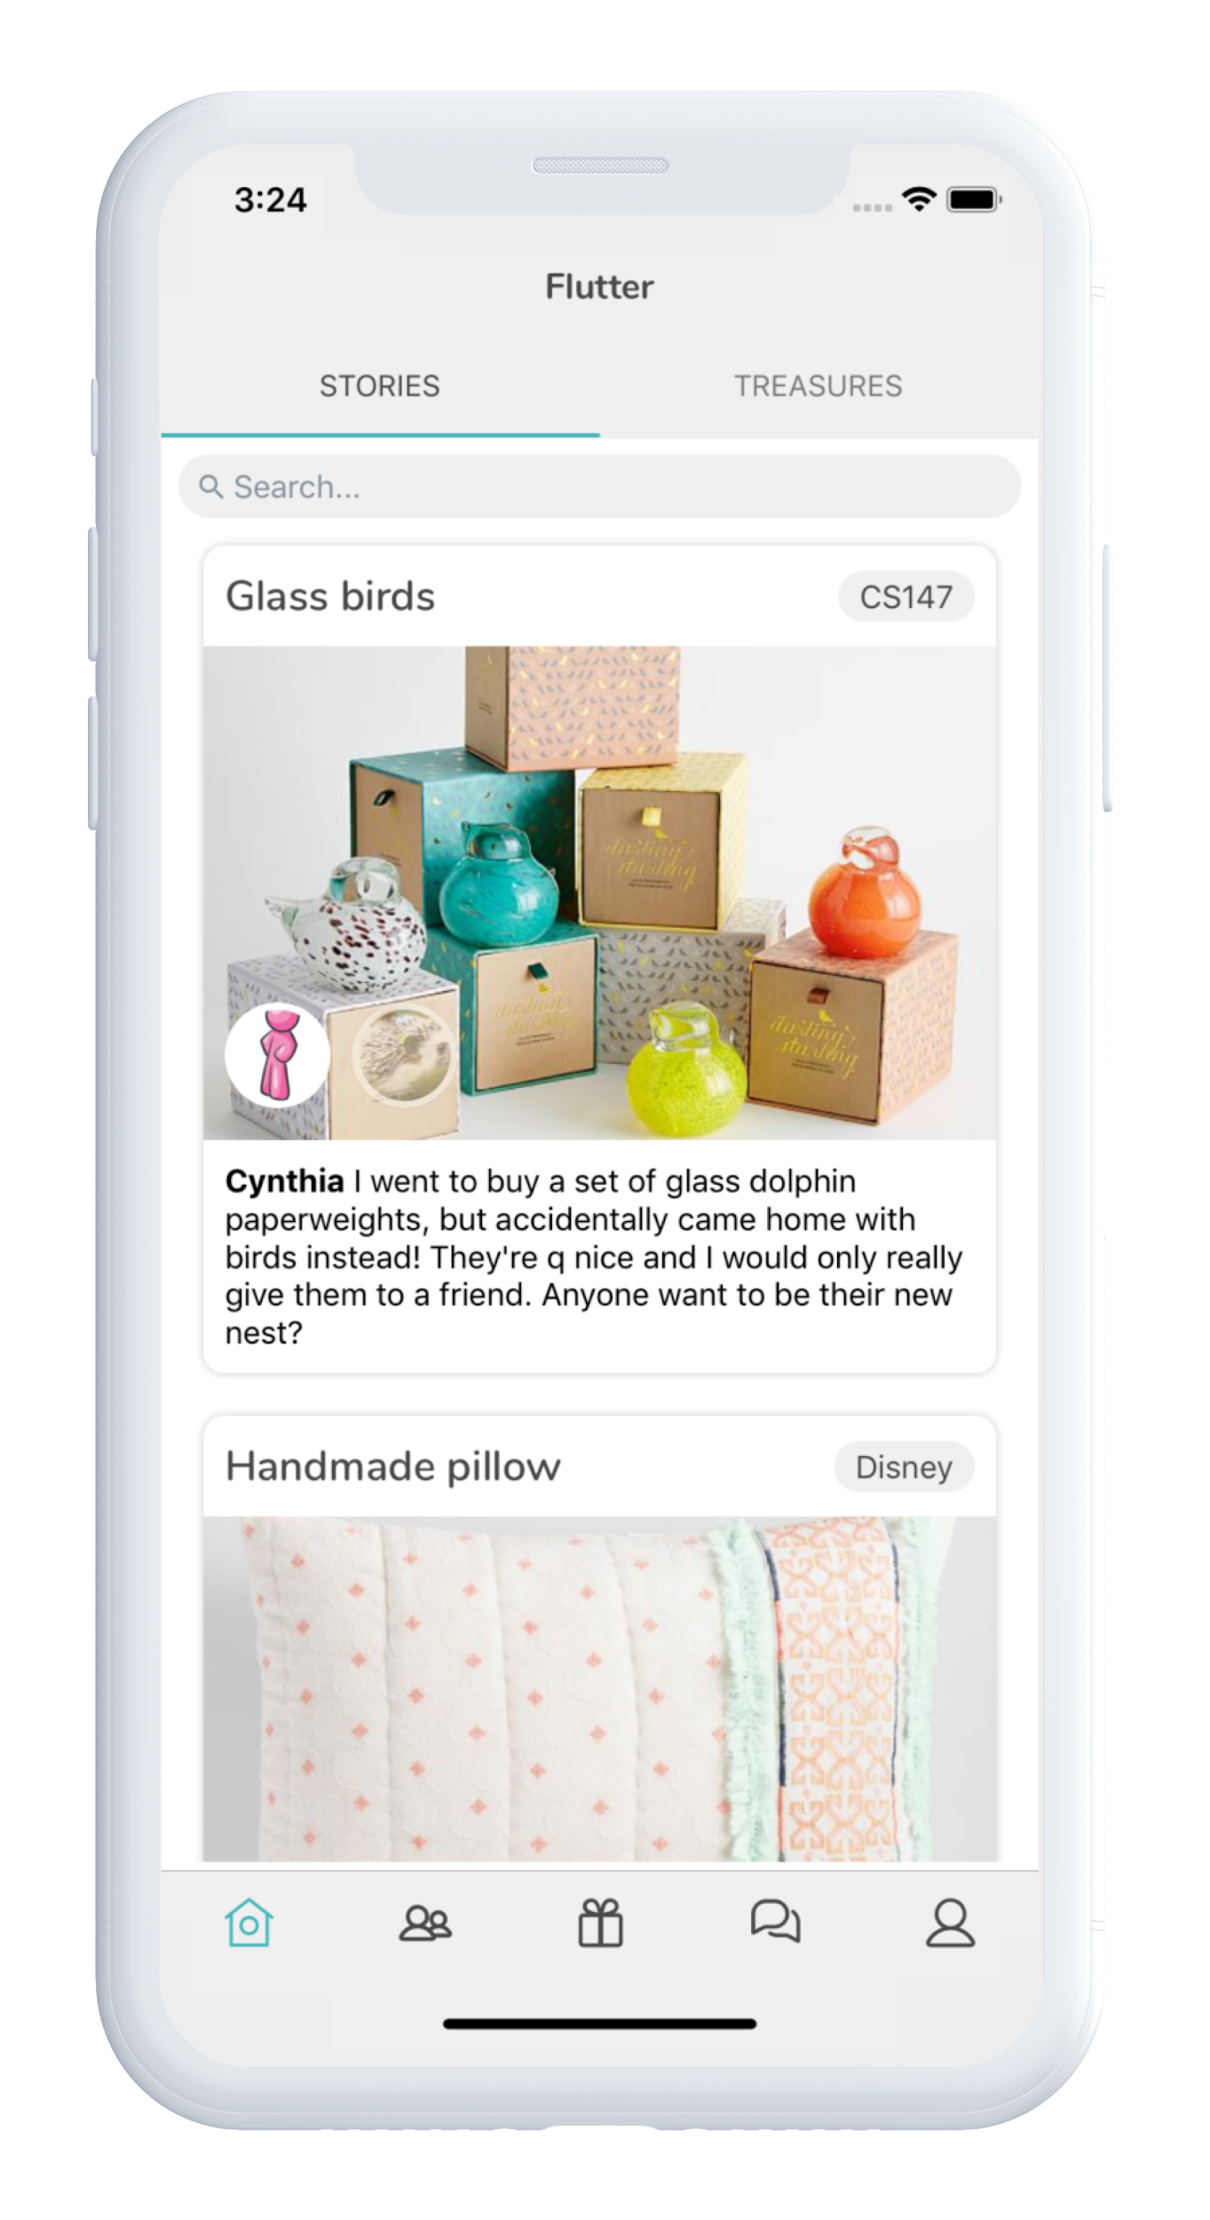
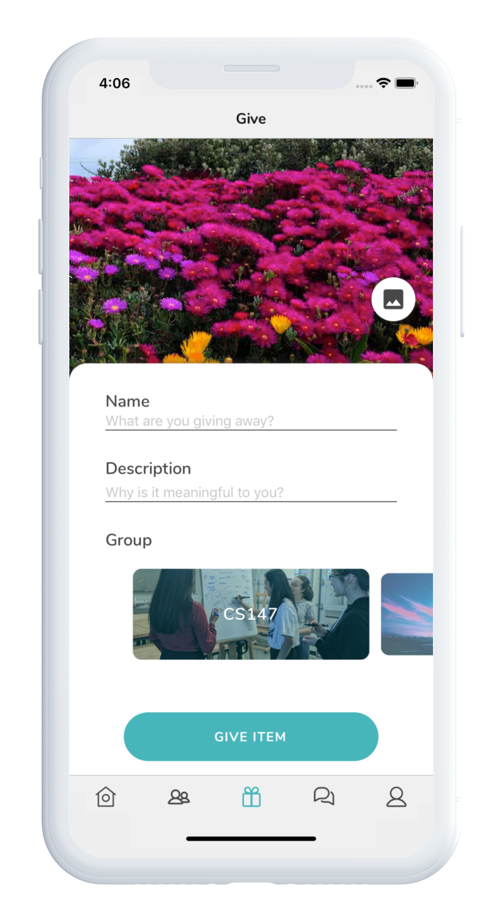
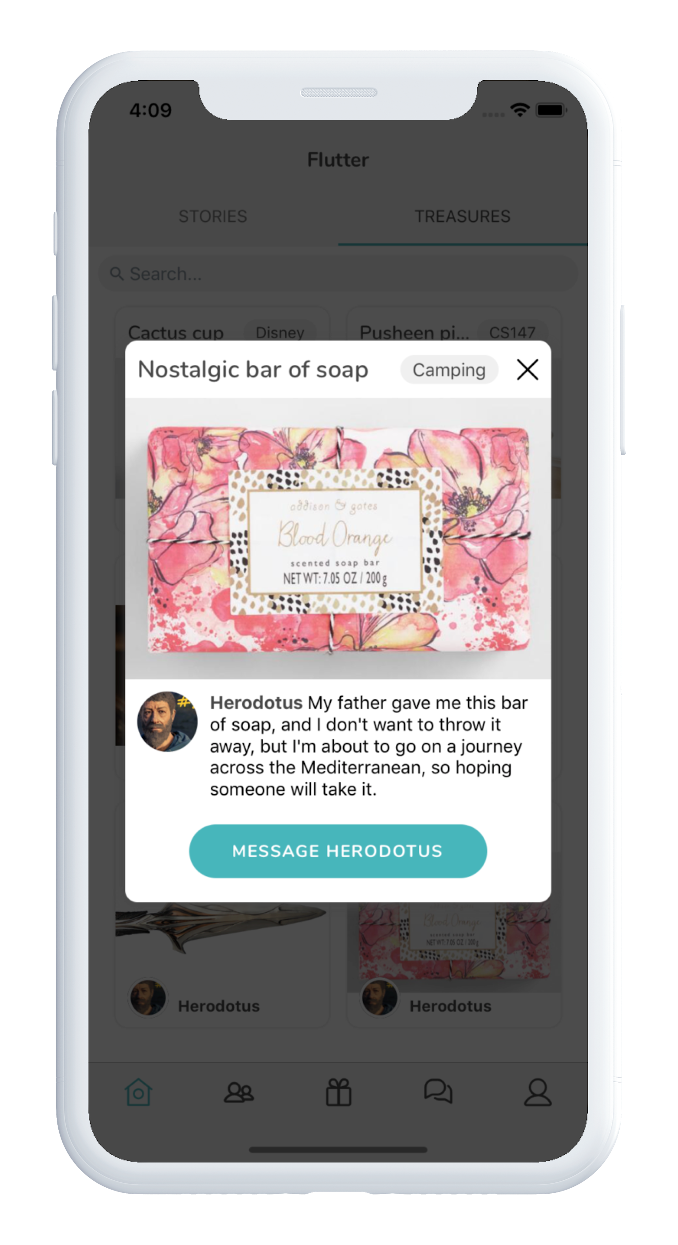
overview
design evolution
demo
future
summary
Notes:
How does flutter encourage receivers of treasured objects to share their side of the story?

Slide 6
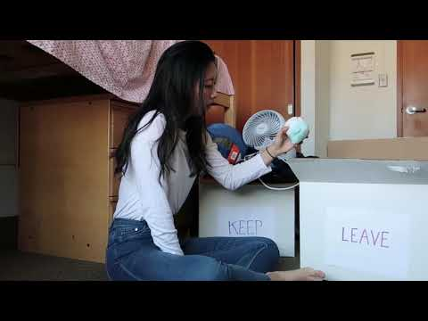
overview
design evolution
demo
future
summary
Notes:
This video was made to demonstrate how an item like a bird can obtain sentimental value and be meaningfully given to the next person via the Flutter platform.

Slide 7
Design Evolution

Slide 8
Needfinding

Slide 9
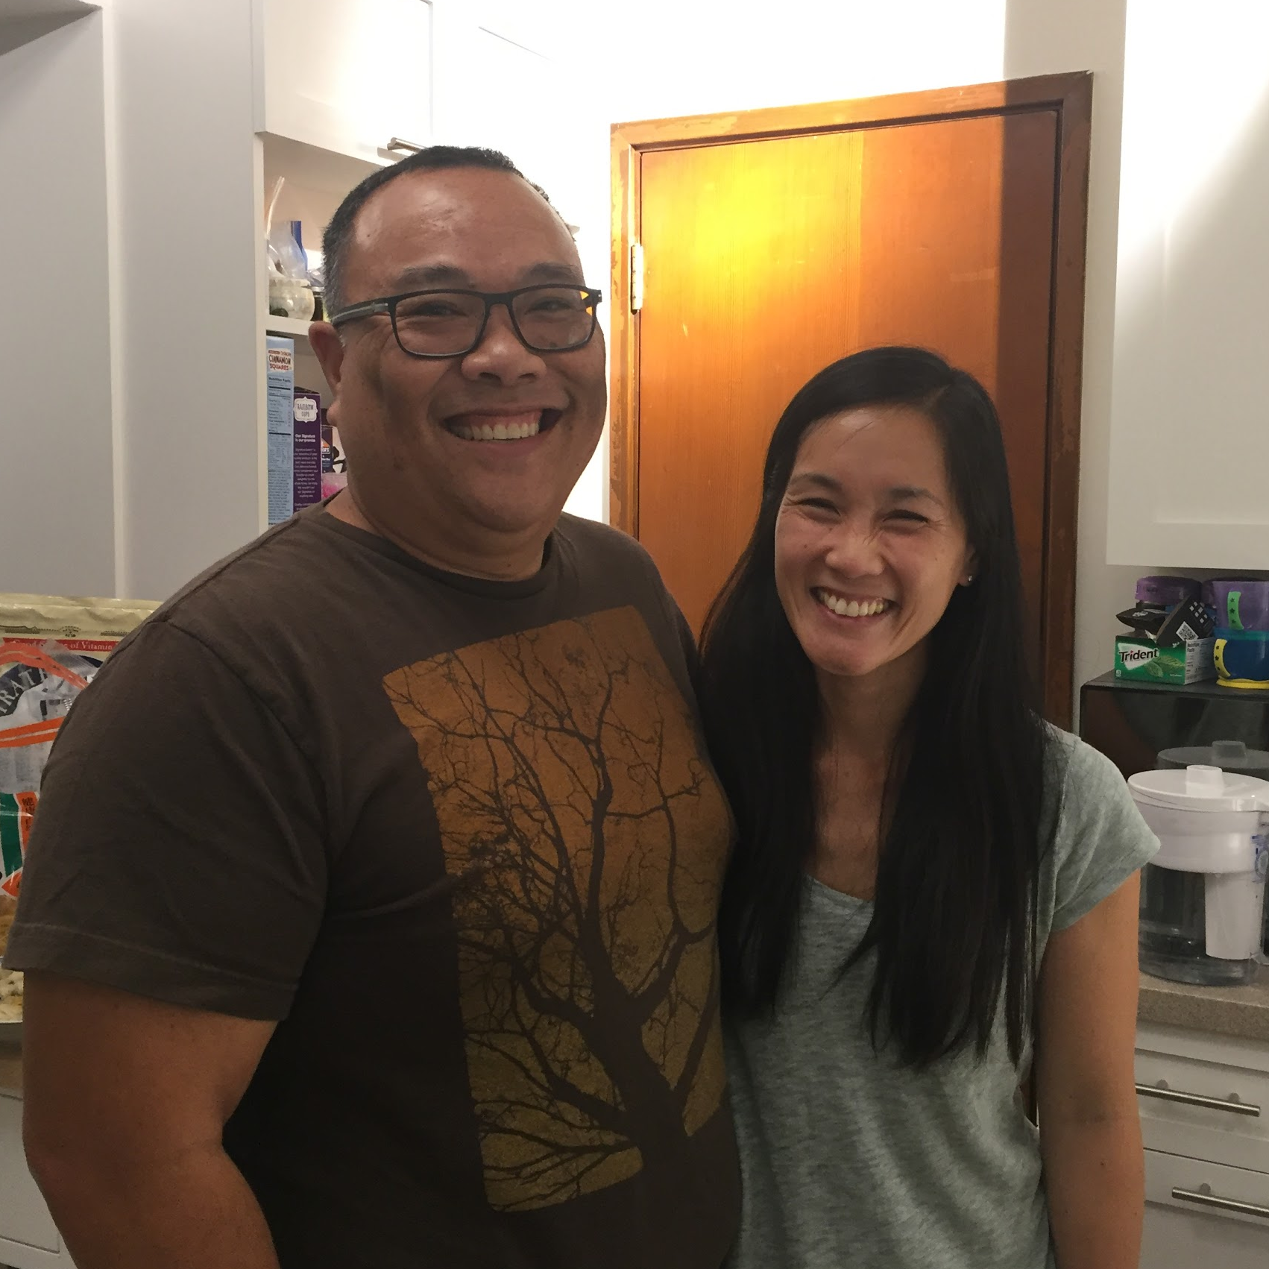

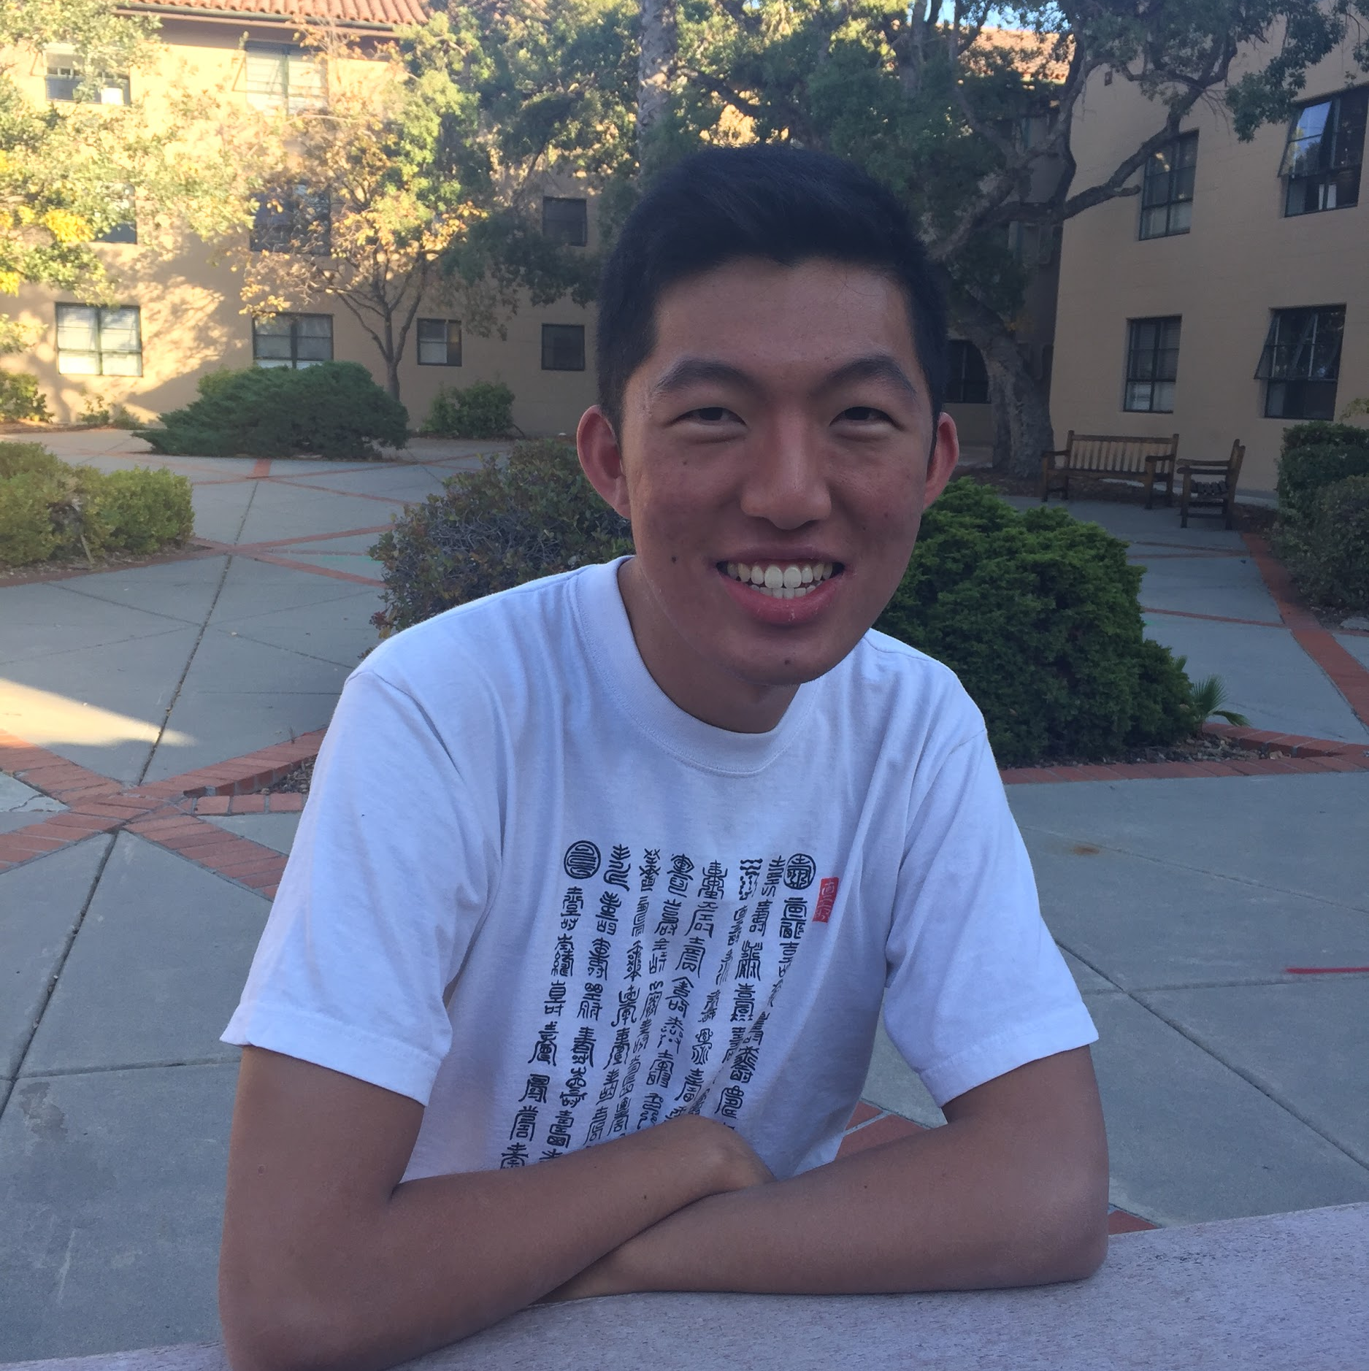
initial point of view
overview
design evolution
demo
future
summary
needfinding
lo-fi
med-fi
hi-fi
Edith
Okada RF
Professor Snipp
Murray RF
Cary
YouTuber
Notes:
Needfinding, round 1: People that move alot and own a lot (second round of need finding)
Edith- value community more than the object itself. Value the people around more than the objects you carry around. Move a lot.
Cary- made object for class. future sentimentality.

Slide 10
overview
design evolution
demo
future
summary
needfinding
lo-fi
med-fi
hi-fi
how might we convert sentimental objects into new experiences that don’t take up physical space?

Slide 11
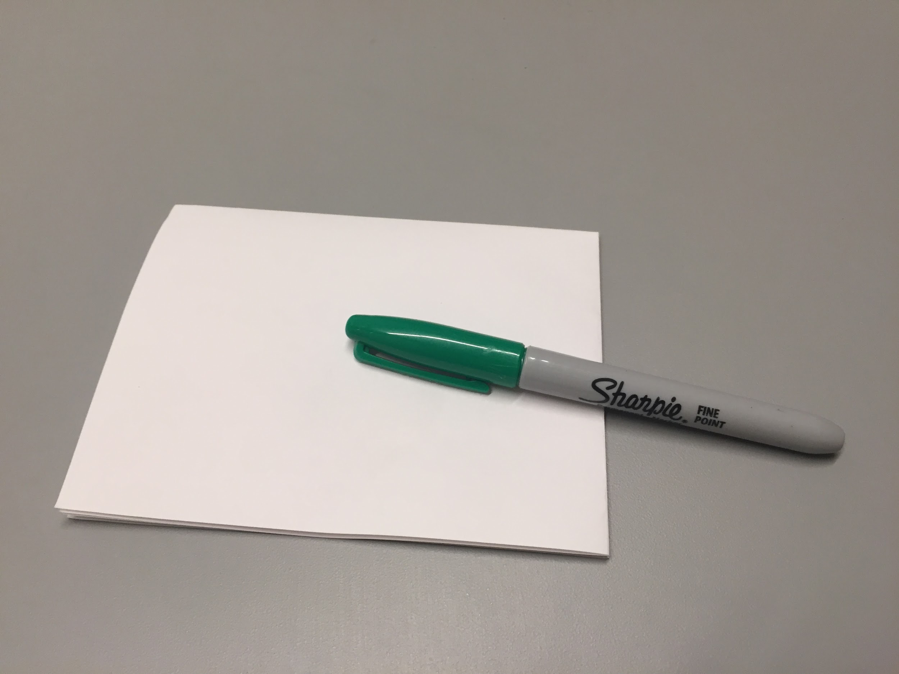
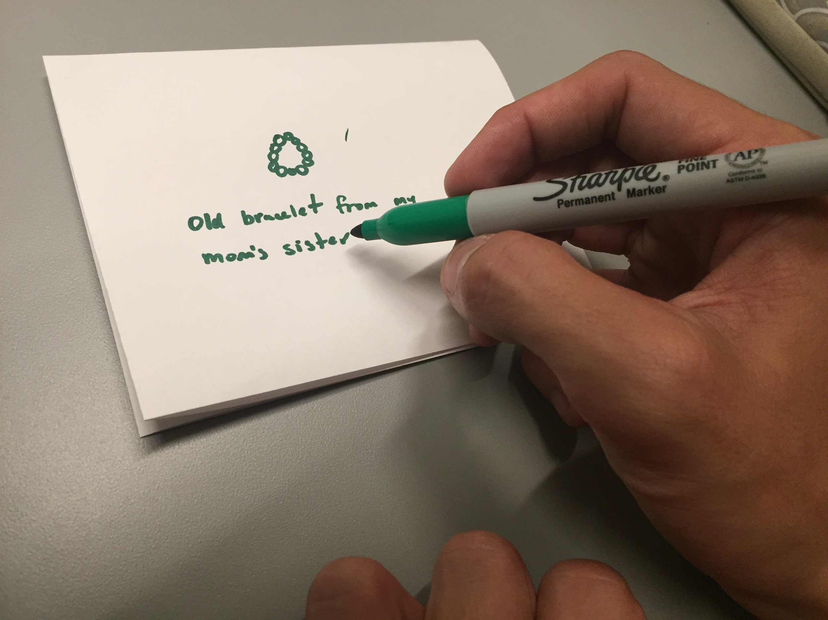
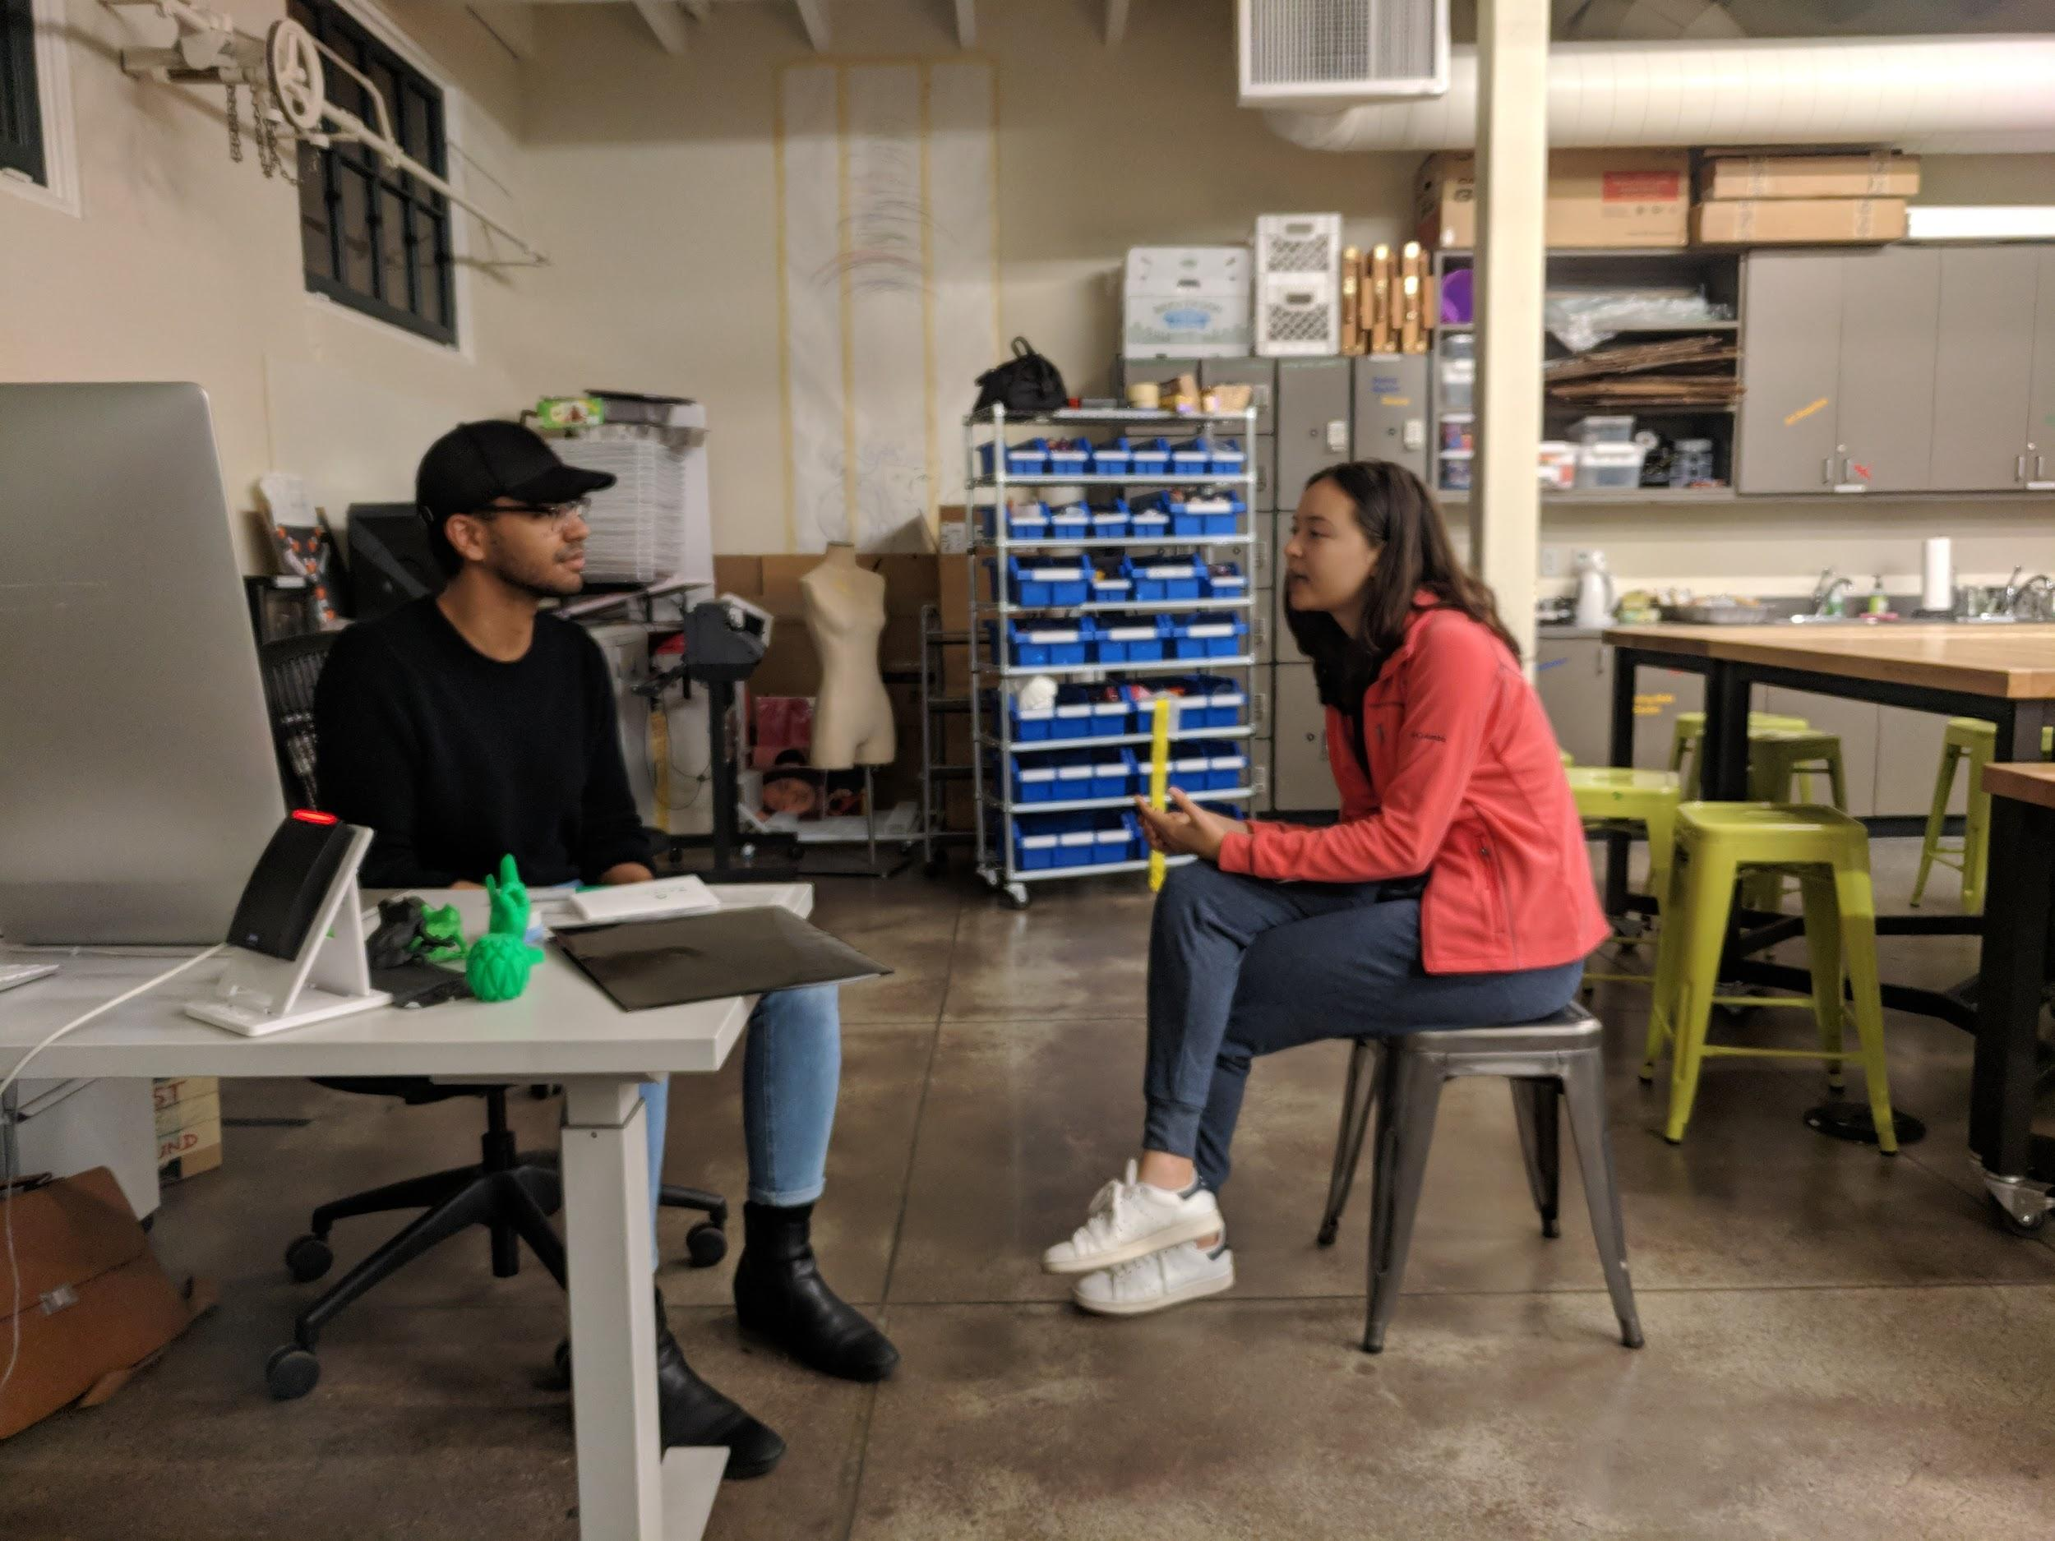
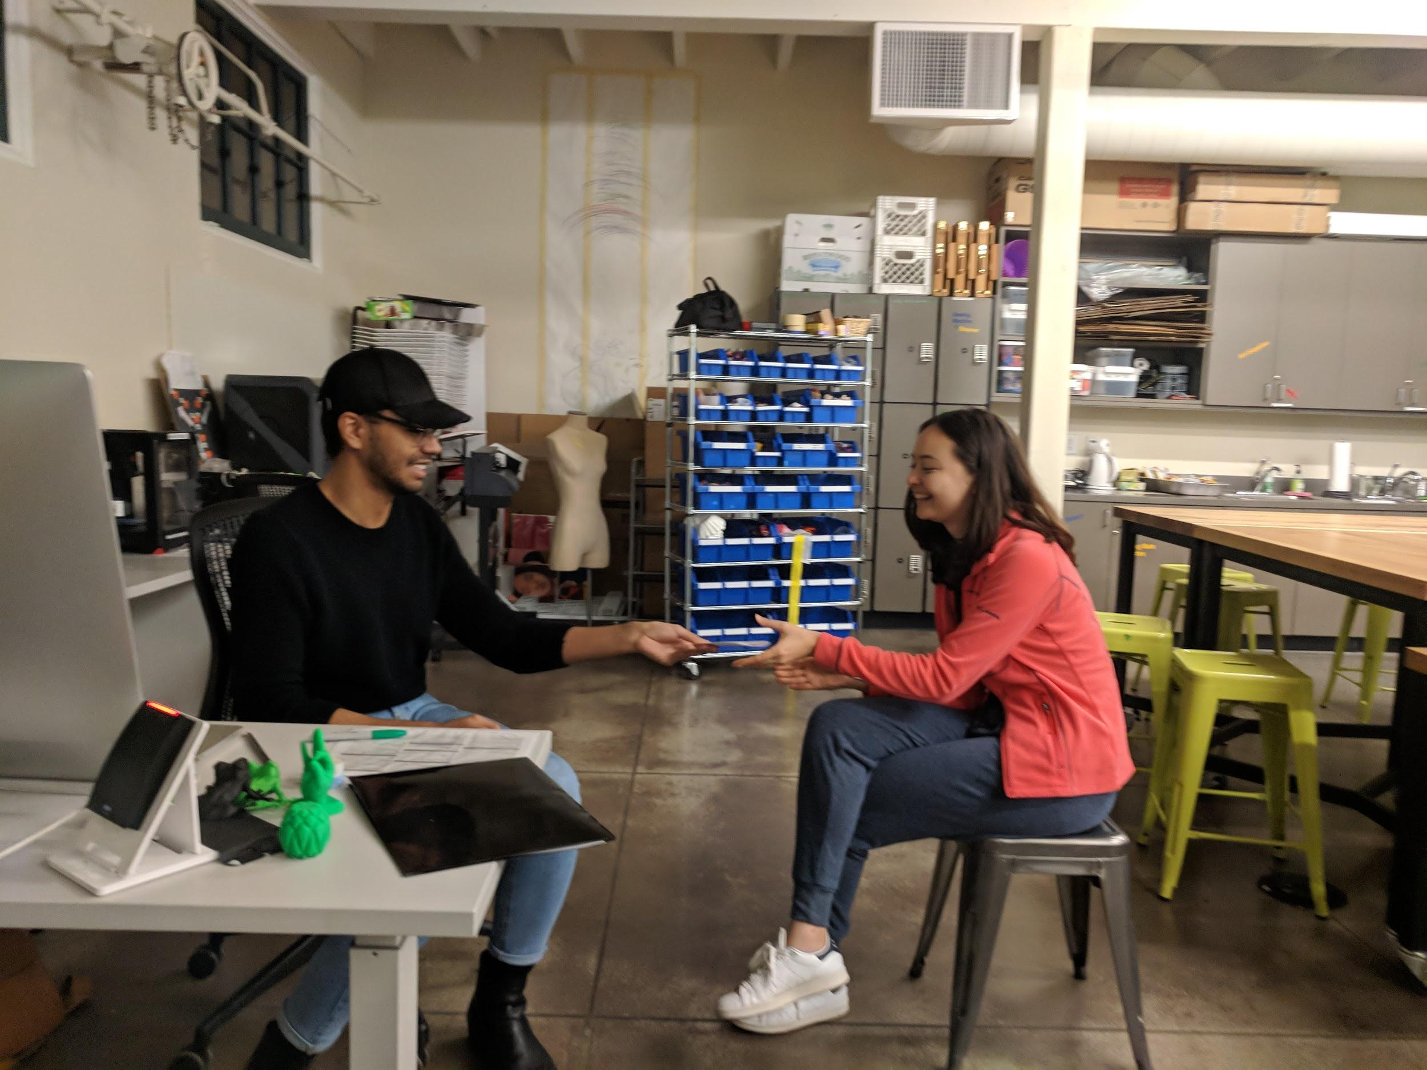
experience prototype
overview
design evolution
demo
future
summary
needfinding
lo-fi
med-fi
hi-fi

Slide 12
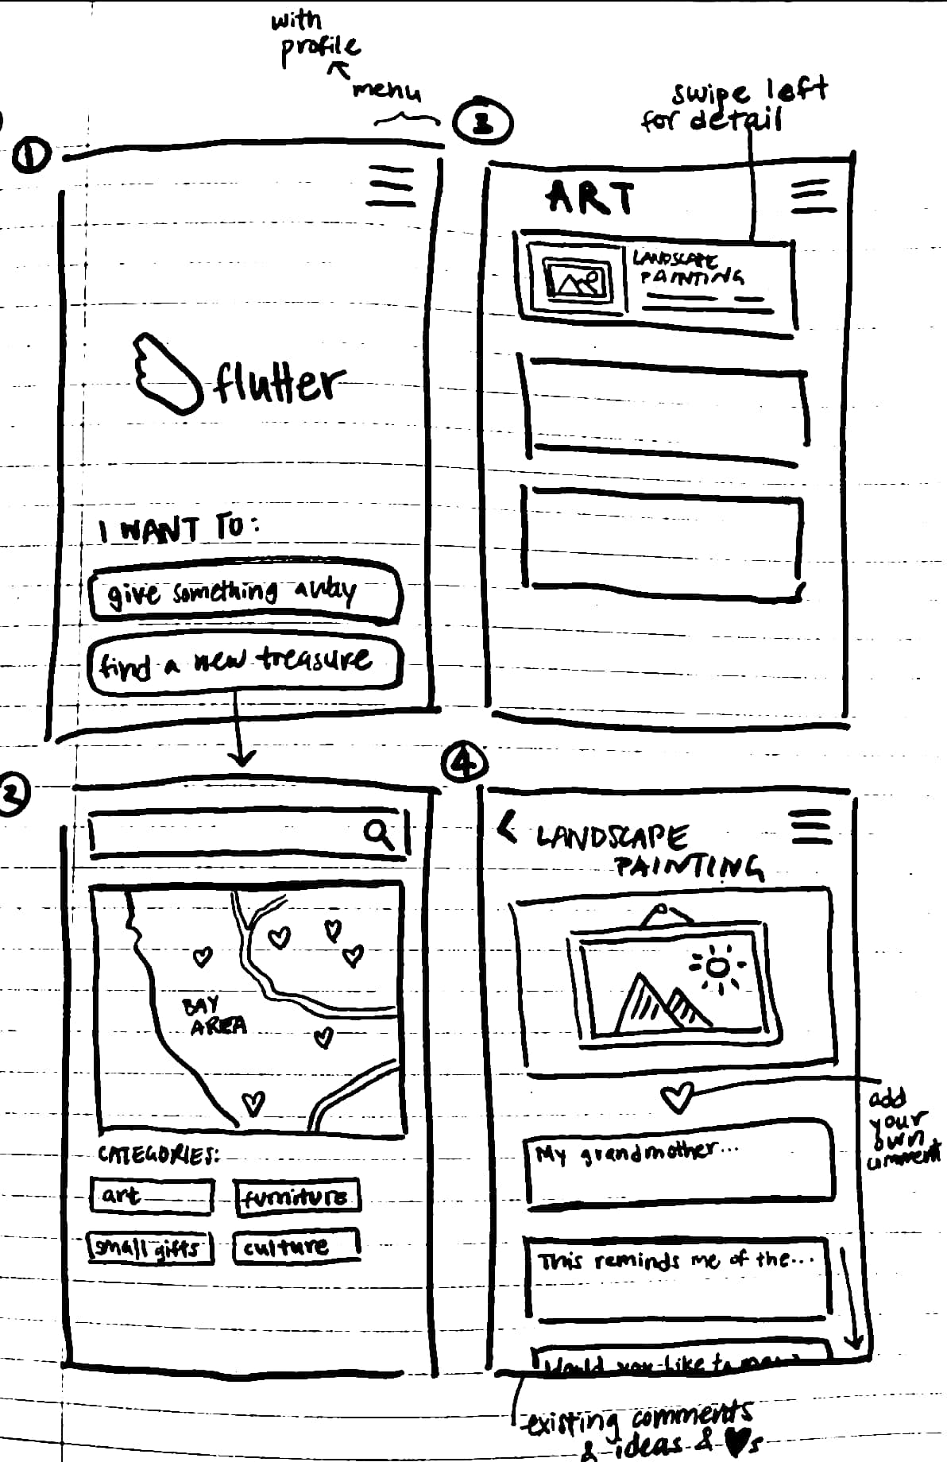
sketches
overview
design evolution
demo
future
summary
needfinding
lo-fi
med-fi
hi-fi
Simple context emphasizes the items' meanings
Focus on location encourages face-to-face experiences
Privacy concerns related to location data
Notes:
First iteration involved a map, which we then scrapped. Since data from our experience prototypes had shown how much people value knowing that their sentimental items will be meaningfully treated, we felt that our pros/cons lists pointed us toward the map design.
Initially, we envisioned a split-path design for our UI. Users would choose whether they were givers or receivers of objects from the home screen (top left), and after choosing, they would be directed to either the giver-specific or receiver-specific paths. Receivers would be able to look through nearby objects by a continuous scrolling feed (top right), by proximity, or by categories (bottom left). Once givers posted an object, potential receivers could comment publically, notifying the giver of why they wanted that specific object (bottom right), and givers would decide based on responses to whom they wanted to give the object.

Slide 13
Lo-fi

Slide 14
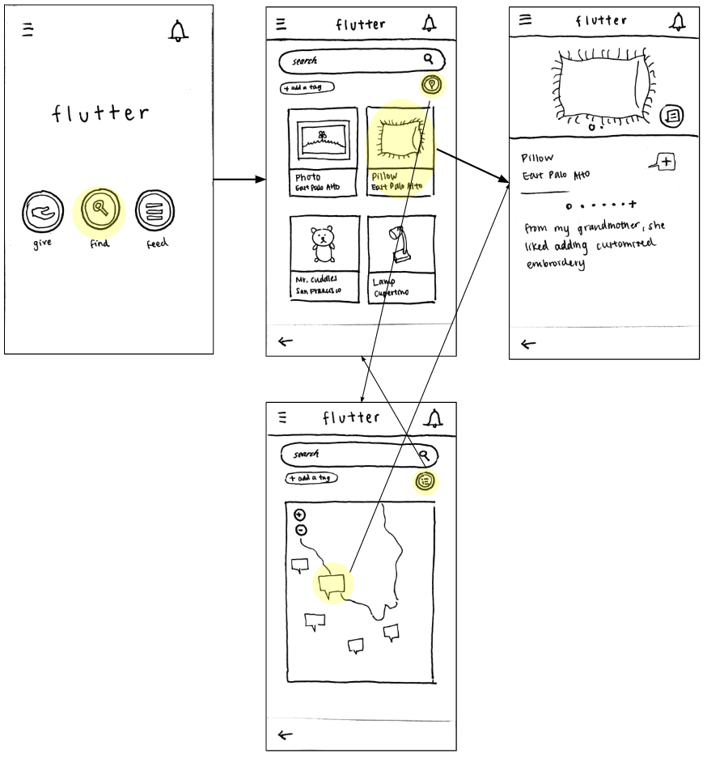
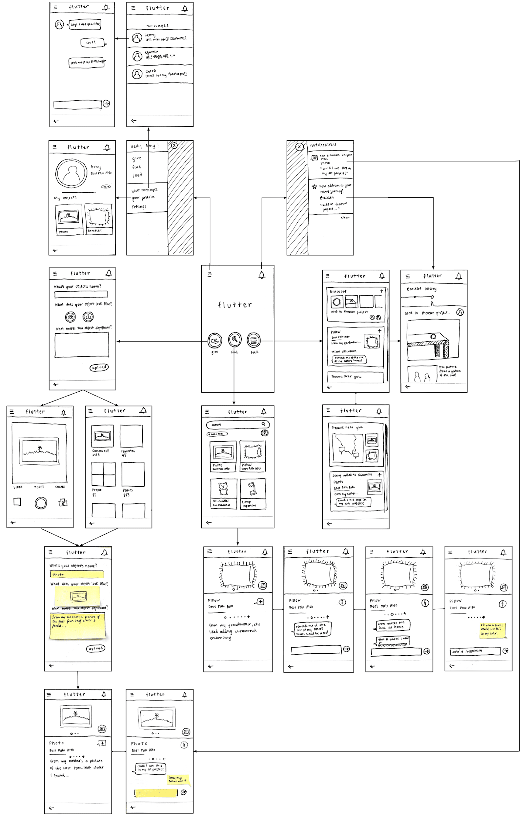
Simple: Find an item
overview
design evolution
demo
future
summary
needfinding
lo-fi
med-fi
hi-fi
Notes:
Users can browse items displayed on a map. Additionally, users who know what they want can search keywords or select from categories/thumbnail images.

Slide 15
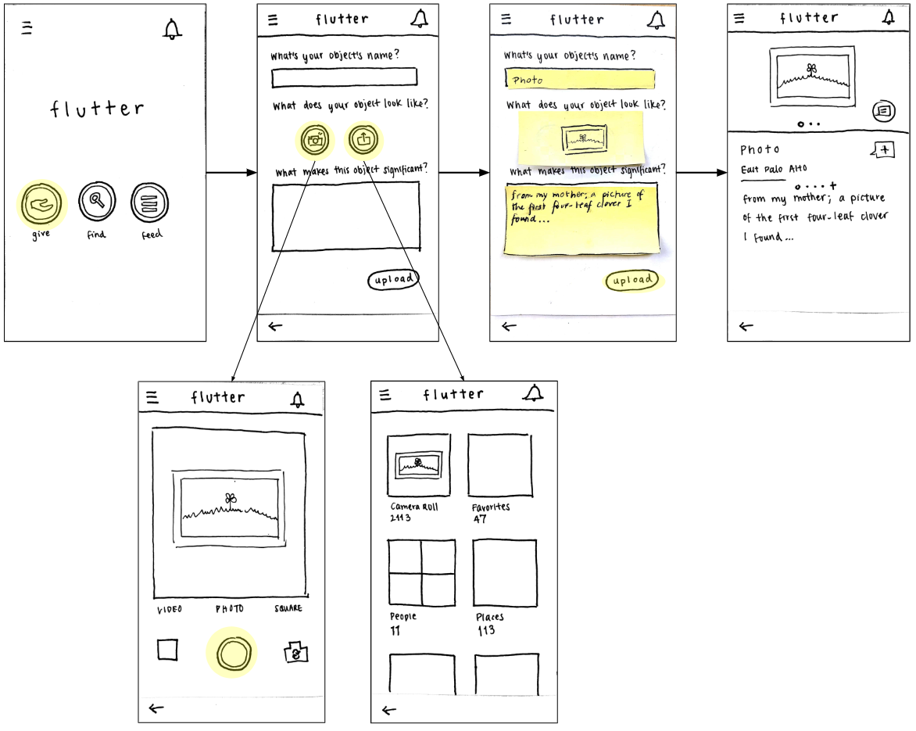
Medium: Give an item
overview
design evolution
demo
future
summary
needfinding
lo-fi
med-fi
hi-fi
Notes:
Users follow a quick workflow to list an item, which includes adding a title, choosing a photo, and describing the item's meaning.

Slide 16
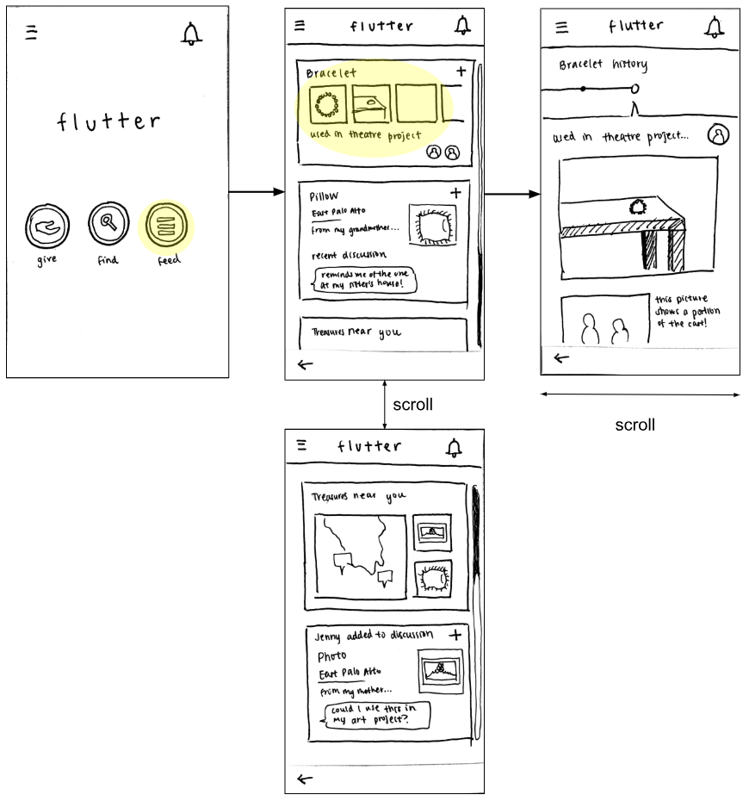
Complex: Connect
& create new experiences
overview
design evolution
demo
future
summary
needfinding
lo-fi
med-fi
hi-fi
Notes:
Users can view an item's story, which includes its original meaning, any public interactions, and its journey after passing hands.

Slide 17
Med-fi
Notes:
Mention that we brainstormed & iterated again (resketches from assign6)

Slide 18
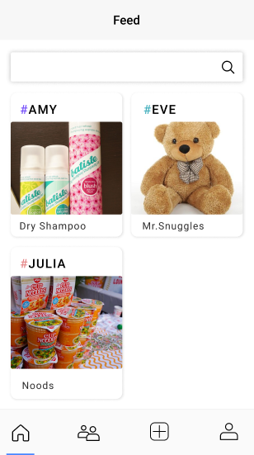
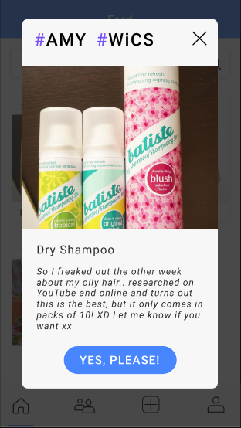
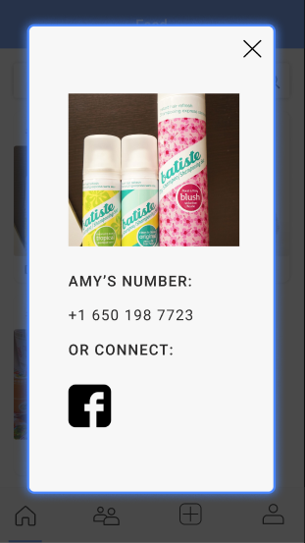
overview
design evolution
demo
future
summary
needfinding
lo-fi
med-fi
hi-fi
find an
object
home/feed
object page
(others)
contact
Notes:
Lack of clarity in the “Yes, please!” button to claim an item

Slide 19
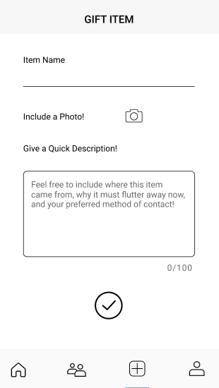
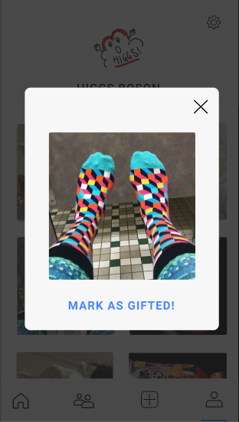
overview
design evolution
demo
future
summary
needfinding
lo-fi
med-fi
hi-fi
give an object
give
object page
(personal)

Slide 20
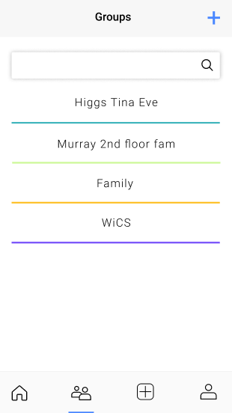
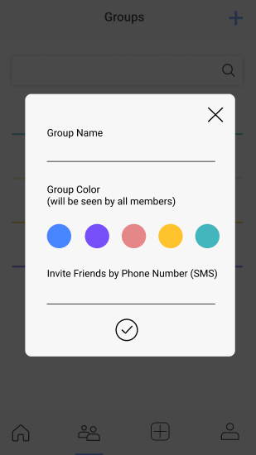
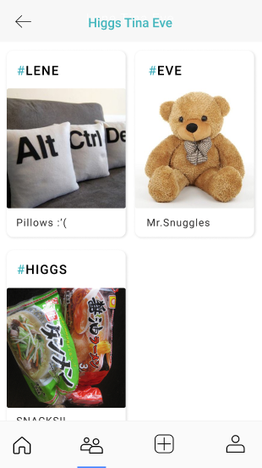
overview
design evolution
demo
future
summary
needfinding
lo-fi
med-fi
hi-fi
create groups to give and receive objects in
groups
new group
group feed

Slide 21
Hi-fi Demo

Slide 22
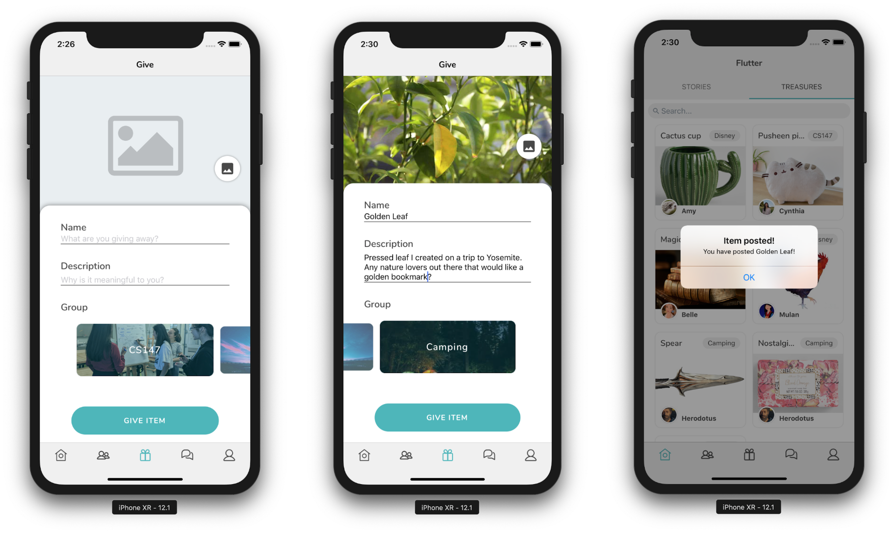

Slide 23
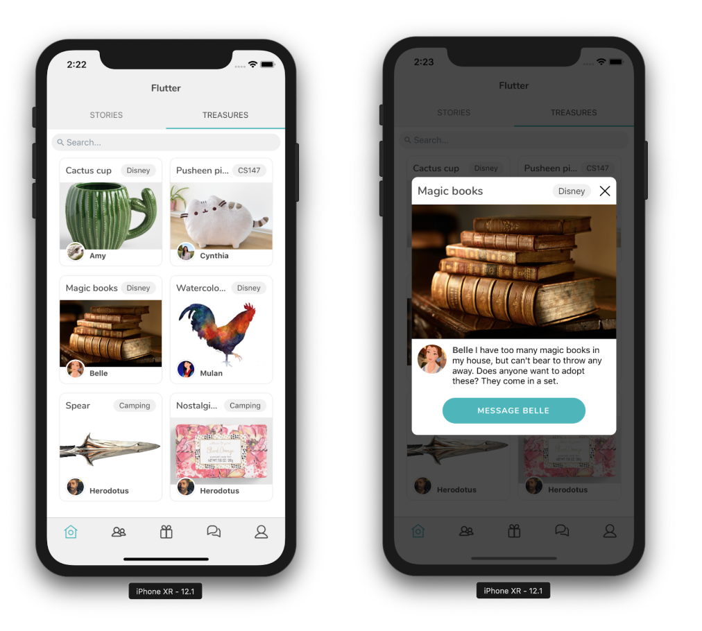

Slide 24
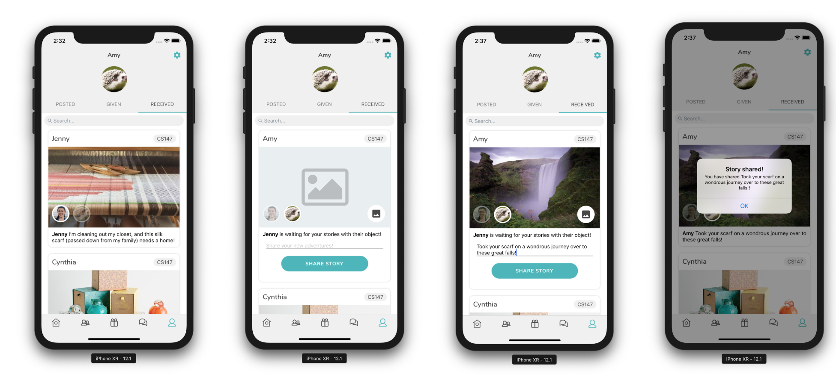

Slide 25
Future

Slide 26
Database
Chat
Search
overview
design evolution
demo
future
summary
Setting object status
Currently global -- make it not so
Extras: object widgets w/i chat
Determine what we want functionality to be like
Implement
Notes:
We also ran into difficulties working with Firebase, and we found that running the application with Firebase made it surprisingly slow. After discovering this, we decided not to continue with Firebase, with the exception of account authentication, for demo purposes, and instead reverted to hard-coded data. Hard-coded data includes all the profiles, groups, objects, and stories.
All of the functionality that we implemented (giving an object, updating stories, creating groups, to name a few) is fully functional and we did not employ any wizard-of-oz techniques. With that said, there was some functionality missing that we plan to add in the future:
Currently the button from objects cards takes the user to a working global chat with every user. We will make the chat private.
Despite having a button from the profile objects cards to set objects as given, we didn’t implement its functionality and intend to complete that.
We have search bars in a number of the screens, but it’s currently not functional. We will work on enabling users to be able to search for stories and objects from descriptions.
There is no way to edit groups, stories, or object posts. We will add this edit functionality.
We plan to add an overlay-style onboarding tutorial the first time the user logs into the application.
We would like users to have the option of logging in via Facebook.
Full implementation with Firebase.

Slide 27
Enhancements to Explore
overview
design evolution
demo
future
summary
Tutorial
Edit functionality
Integration w/ facebook api
Location

Slide 28
Summary
Notes:
People often own more things than they actually use, causing clutter in their lives. In most cases, this is due to some level of sentimental attachment to the object. People need trust and emotional security to encourage the process of decluttering. Flutter aids this decluttering process by building on a person’s existing communities, ensuring the trust component, to give and receive objects, as well as allowing for emotional continuity of these objects through encouraging sharing of stories between giver and receiver. We received a lot of positive feedback from the project expo, and are excited to continue adding functionality to Flutter.

